Slide 1
Vector FPU
Ruei-Yuan (2019/6/12)

Slide 2
Vector FPU
Support 16-bit (half-precision), 32-bit (single-precision) operations
Support vector/scalar floating-point instructions
Fix latency for the vector/scalar floating-point instructions

Slide 3
Vector FPU
II
V1
V2

Slide 4
Vector FPU

Slide 5
Vector FPU per Lane (64-bit)
32’b0 or {16’b0, [63:48]}
32/16-bit FPU pipeline
32’b0 or {16’b0, [63:48]}
32’b0 or {16’b0, [47:32]}
32/16-bit FPU pipeline
32’b0 or {16’b0, [47:32]}
[63:32] or {16’b0, [31:16]}
32/16-bit FPU pipeline
[63:32] or {16’b0, [31:16]}
[31:0] or {16’b0, [15:0]}
32/16-bit FPU pipeline
[31:0] or {16’b0, [15:0]}

Slide 6
Vector FPU Pipeline
32
32/16-bit FMAC Pipeline
32/16-bit FPU MISC/CVT Pipeline
32/16-bit FPU DIV/SQRT Pipeline

Slide 7
Vector FPU Interface
input [`VRF_MASK_RANGE] vfxxx_clr_bits;
input [1:0] vfxxx_csr_ediv;
input [`EX_CTRL_RANGE] vfxxx_ex_ctrl;
input [`MOP_CNT_RANGE] vfxxx_mop_cnt;
input [`VRF_MASK_RANGE] vfxxx_msk_bits;
input [2:0] vfxxx_rmode;
input [`DATA_RANGE] vfxxx_rs1_data;
input vfxxx_rs1_valid;
input vfxxx_valid;
input [`CSR_LMUL_RANGE] vfxxx_vtype_lmul;
input [`SEW_RANGE] vfxxx_vtype_sew;
Input vfxxx_wide; // indicate the widening operation
output [`VRF_MASK_RANGE] vfxxx_mask;
output [`VRF_DATA_RANGE] vfxxx_data;
output [4:0] vfxxx_vfcsr_flag_set;
Note: xxx includes: mac, div, mis

Slide 8
Vector FPU Pipeline
FPU FMAC pipeline: ADD/SUB/MUL/MADD/MSUB/REDSUM/DOT instructions
FPU DIV pipeline: DIV/SQRT instructions
FPU MISC/CVT pipeline: CMP/MERGE/SIGN/MIN/MAX/CLASS/CVT/REDMAX/REDMIN/MV instructions

Slide 9
FMAC Pipeline (subnormal input)
V2
VF1
sub
VF2
VF3
op1
HA
sum
Hidden1
Gen
MUL
3:2
CSA
Sum
op2
HA
carry
op1
unpacked
op2
HA
carry
Carry
op3
Stick
Calc.
St1
St1
INV
71-bits Alignment Shift
CLZ pos
op3
Hidden1
Gen
LZA
CLZ neg
exp1
SHIFT
Amount
Calc.
Sign-detection
exp2
exp3

Slide 10
FMAC Pipeline (unpacked logic)
Unpacked logic includes:
16-bit unpacked
32-bit unpacked

Slide 11
FMAC Pipeline (subnormal output)
VF2
VF3
VF4
5-bit adder
St1
Sum
Normalization Shifter
<<
4-bit low part adder
5-bit adder
Carry
LZA
St1
sign
rounding mode
Subnorm?
EXP
LSB-adder
Carry and stick Calc.
Round Decision
LSB-adder
LSB-adder
inc
ovf
LSB Correction & special value detection
Dual-adder
Result
Select
decision
EXP result
Result

Slide 12
FMAC Pipeline (subnormal output detection)
Before normalization shifter:
Case1 (EXP>-126): 0.0001xxx*2^100
LZA result (4) for normalization shifter
After normalization 1.xxx*2^96
Case2 (EXP>-126): result 0.0001xxx*2^-125
LZA result (4) for normalization shifter
After normalization 1.xxx*2^-129
Case3 (EXP<-126): result 0.0001xxx*2^-130
LZA result (4) for normalization shifter
After normalization 1.xxx*2^-134

Slide 13
FMAC Pipeline (proposed subnormal output detection)
Example:
Case1: 0.0001xxx*2^100
EXP(100) and (EXP(100) – LZA(4) =96) > -126
Select 4 (LZA result) for normalization shifter
After normalization 1.xxx*2^96
Case2: result 0.0001xxx*2^-125
EXP(-125) > -126 and (EXP(-125) – LZA(4) =-129) < -126
Select 1 (EXP(-125) + 126) for normalization shifter
After normalization 0.001xxx*2^-127
Case3: result 0.0001xxx*2^-127
EXP(-127) < -126
Select 0 for normalization shifter
After normalization 0.0001xxx*2^-127

Slide 14
FMAC Pipeline (subnormal output)
VF2
VF3
VF4
5-bit adder
St1
Sum
Normalization Shifter
<<
4-bit low part adder
5-bit adder
Carry
LZA
St1
sign
rounding mode
Subnorm?
EXP
LSB-adder
Carry and stick Calc.
Round Decision
LSB-adder
LSB-adder
inc
ovf
LSB Correction & special value detection
Dual-adder
Result
Select
decision
EXP result
Result

Slide 15
FMAC Pipeline(proposed subnormal output detection)
VF2
VF3
VF4
Sum
Normalization Shifter
<<
Carry
LZA
EXP-LZA
Subnormal?
EXP
Subnormal
predict
if (EXP < -126)
select 0
else if (EXP-LZA) < -126
select EXP + 126
else
select LZA
adder
126
0
Final EXP?

Slide 16
FMAC Pipeline (subnormal output)
VF2
VF3
VF4
5-bit adder
St1
Sum
Normalization Shifter
<<
4-bit low part adder
5-bit adder
Carry
LZA
St1
sign
rounding mode
Subnorm?
EXP
LSB-adder
Carry and stick Calc.
Round Decision
LSB-adder
LSB-adder
inc
ovf
LSB Correction & special value detection
Dual-adder
Result
Select
decision
EXP result
Result

Slide 17
FMAC Pipeline (proposed subnormal output detection)
Corner case:
Case4: result 0.1111…*2^-127 (maximum subnormal value)
EXP(-127) < -126
Select 0 for normalization shifter
After normalization 0.1111…*2^-127
If the final result‘s (fraction) MSB is 1 (e.g.: 1.0000…) after rounding, it the EXP will be modified from 0 to -126 for 1.0000…*2^-126 (minimum normalization value)

Slide 18
FMAC Pipeline(proposed subnormal output detection)
VF2
VF3
VF4
if (subnormal & Result MSB==0)
select 0
else if (subnormal & Result MSB==1)
select -126
else
select (EXP-LZA)
Sum
Normalization Shifter
<<
Carry
LZA
EXP-LZA
Subnormal
predict
Result MSB
EXP
if (EXP < -126)
select 0
else if (EXP-LZA) < -126
select EXP + 126
else
select LZA
Subnormal
detection
adder
126
0
0
-126
EXP result

Slide 19
DIV Pipeline
V2
VF1
VF2
VF3
Vector
Register
file
op1
Subnormal detection & normalization
div_op1
Divider
result0
op2
div_op2
result1
FSM
V2
VF1
div_op1
op1
Subnormal normalization
Subnormal detection
div_op2
op2
Subnormal normalization
Subnormal detection

Slide 20
DIV Pipeline
VF2
VF3
VF4
rounding mode
remainder0
adder & stick Gen.
Round & Stick
remainder1
Round Decision
quotient_sel
quotient0
Subnormal Shifter
>>
quotient1
special value
detection
result
Result+1
exp
Special Value Detection

Slide 21
Reduction Sum Operation (Unordered) per Lane (64-bit)
FMAC pipe3
Vs2[3]
FMAC pipe2
FMAC pipe2
Vs2[2]
FMAC pipe0
FMAC pipe1
Vs2[1]
FMAC pipe0
FMAC pipe0
Vs2[0]
Vs1[0]
4T
4T
4T

Slide 22
Reduction Sum Operation (Unordered) per Lane
Operation: vd[0] = sum( vs2[*] , vs1[0] )
Lane0 | Result(T0) | Result(T1) | Result(T2)
pipe0 | Vs1[0]+Vs2[0] | P0_T0+Vs2[1] | P0_T1+P2_T1
Pipe1 | x | x | x
Pipe2 | x | Vs2[2]+Vs2[3] | x
Pipe3 | x | x | x
LMUL=1, T= 4 cycles

Slide 23
Widening Reduction Sum Operation (Unordered) per Lane
Operation: vd[0] = sum( vs2[*] , vs1[0] )
Lane0 | Result(T0) mop0 | Result(T1) mop0 | Result(T2) mop1 | Result(T2) mop1
pipe0 | Vs1[0]+Vs2[0] | P0_T0+Vs2[1] | P0_T1+Vs2[2] | P0_T2+Vs2[3]
Pipe1 | x | x | x
Pipe2 | x | x | x
Pipe3 | x | x | x
LMUL=1, T= 4 cycles
The widening reduction sum (unordered) will be decomposed to the micro-instructions

Slide 24
Reduction Sum Operation per Lane
Reduction control
V2 stage
FMAC pipeline3
op1
op3
Vs2[2]
FMAC pipeline2
op1
Vs2[3]
op3
FMAC pipeline1
op1
op3
Vs2[0]
FMAC pipeline0
Vs1[0]
op1
op3

Slide 25
Reduction Sum Operation per Lane
Reduction control
Vs2[3]
FMAC pipeline3
Vs2[3]
op1
op3
FMAC pipeline2
Vs2[2] + Vs2[3]
op1
op3
FMAC pipeline1
Vs2[1]
op1
op3
Vs2[1]
FMAC pipeline0
Vs2[0]+Vs1[0]
op1
op3

Slide 26
Reduction Sum Operation per Lane
Reduction control
FMAC pipeline3
op1
op3
FMAC pipeline2
Vs2[2]+Vs2[3]
op1
op3
FMAC pipeline1
op1
op3
FMAC pipeline0
Vs2[1]+Vs2[0]+Vs1[0]
op1
op3

Slide 27
Reduction Sum Operation per Lane
Reduction control
FMAC pipeline3
op1
op3
FMAC pipeline2
op1
op3
FMAC pipeline1
op1
op3
FMAC pipeline0
op1
op3
Vs2[2]+Vs2[3]
Vs2[1]+Vs2[0]+Vs1[0]

Slide 28
Reduction Sum Operation (Unordered) per Lane
Operation: vd[0] = sum( vs2[*] , vs1[0] )
Lane0 | Result(T0) | Result(T1) | Result(T2)
pipe0 | V4[0]+V8[0] | P0_T0+V5[0] | P0_T1+V6[0]
Pipe1 | x | V4[1]+V5[1] | P1_T1+V6[1]
Pipe2 | x | V4[2]+V5[2] | P2_T1+V6[2]
Pipe3 | x | V4[3]+V5[3] | P3_T1+V6[3]
LMUL>1, T= 4 cycles, e.g.: LMUL=4, and Vs2=V4,V5,V6,V7 and Vs1=V8

Slide 29
Reduction Sum Operation (Unordered) per Lane
Operation: vd[0] = sum( vs2[*] , vs1[0] )
Lane0 | Result(T3) | Result(T4) | Result(T5)
pipe0 | P0_T2+V7[0] | P0_T3+P1_T3 | P0_T4+P1_T4
Pipe1 | P1_T2+V7[1] | x | x
Pipe2 | P2_T2+V7[2] | P2_T3+P3_T3 | x
Pipe3 | P3_T2+V7[3] | x | x
LMUL>1, T= 4 cycles, e.g.: LMUL=4, and Vs2=V4,V5,V6,V7 and Vs1=V8

Slide 30
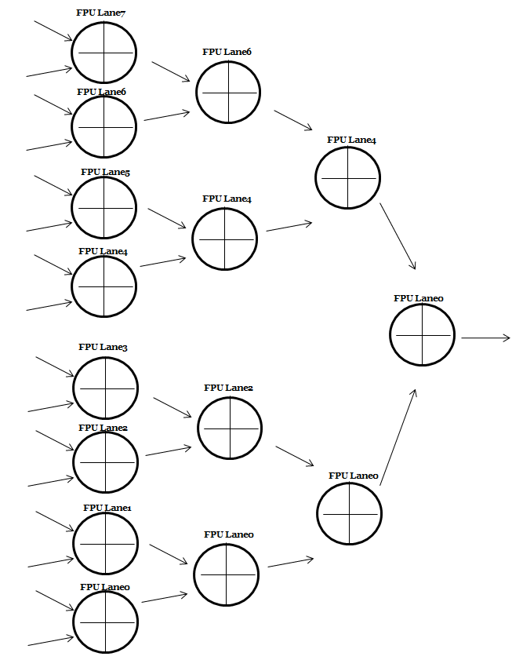
Reduction Sum Operation (Unordered)
Vs2[N]
Vs1[N]
.
.
.
Vs2[1]
Vs1[0]
4T*LMUL+8T
4T
4T
4T

Slide 31
Reduction Sum Operation (Unordered) for Lane
 | Result(T0) | Result(T1) | Result(T2) | Result(T3)
Lane0 | L0_T0 | L0_T0+L1_T0 | L0_T1+L2_T1 | L0_T2+L4_T2
Lane1 | L1_T0 | x | x
Lane2 | L2_T0 | L2_T0+L3_T0 | x
Lane3 | L3_T0 | x | x
Lane4 | L4_T0 | L4_T0+L5_T0 | L4_T1+L6_T1
Lane5 | L5_T0 | x | x
Lane6 | L6_T0 | L6_T0+L7_T0 | x
Lane7 | L7_T0 | x | x
LMUL>=1, T0= 4*LMUL + 8 cycles, T1, T2, T3 = 4 cycles

Slide 32
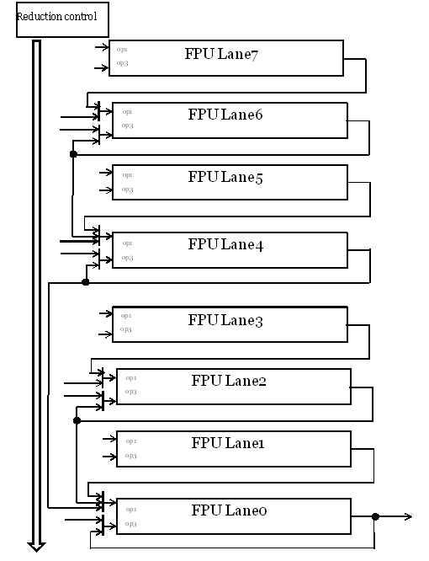
Reduction Sum Operation

Slide 33
Reduction Sum Operation (step1 * LMUL)

Slide 34
Reduction Sum Operation (step 2)

Slide 35
Reduction Sum Operation (step 3)

Slide 36
Reduction Sum Operation (step 4)

Slide 37
Reduction Sum (Unordered) Instructions Latency
Instruction | Latency (sew=16)
Reduction sum (unordered) | ((Log2(elements)*4) + 4)*LMUL 4*LMUL+20
Instruction | Latency (sew=32)
Reduction sum (unordered) | (Log2(elements)*4)*LMUL 4*LMUL+16

Slide 38
Reduction Sum Operation (Ordered)
Reuse the unordered logic for the reduction sum ordered operation.

Slide 39
Reduction Sum Operation per Lane
Reduction control
Vs2[3]
FMAC pipeline3
op1
op3
Vs2[2]
FMAC pipeline2
op1
op3
Vs2[1]
FMAC pipeline1
op1
op3
Vs2[0]
FMAC pipeline0
Vs1[0]
op1
op3

Slide 40
Reduction Sum Operation per Lane
Reduction control
Vs2[3]
FMAC pipeline3
op1
op3
Vs2[2]
FMAC pipeline2
op1
op3
Vs2[1]
FMAC pipeline1
op1
op3
Vs2[1]
FMAC pipeline0
Vs1[0] + Vs2[0]
op1
op3

Slide 41
Reduction Sum Operation per Lane
Reduction control
Vs2[3]
FMAC pipeline3
op1
op3
Vs2[2]
FMAC pipeline2
op1
op3
Vs2[1]
FMAC pipeline1
op1
op3
Vs2[2]
FMAC pipeline0
Vs1[0] + Vs2[0]+Vs2[1]
op1
op3

Slide 42
Reduction Sum Operation per Lane
Reduction control
Vs2[3]
FMAC pipeline3
op1
op3
Vs2[2]
FMAC pipeline2
op1
op3
Vs2[1]
FMAC pipeline1
op1
op3
Vs2[3]
FMAC pipeline0
Vs1[0] + Vs2[0]+Vs2[1]+Vs2[2]
op1
op3

Slide 43
Reduction Sum Operation per Lane
Reduction control
Vs2[3]
FMAC pipeline3
op1
op3
Vs2[2]
FMAC pipeline2
op1
op3
Vs2[1]
FMAC pipeline1
op1
op3
FMAC pipeline0
Vs1[0] + Vs2[0]+Vs2[1]+Vs2[2]+Vs2[3]
op1
op3

Slide 44
Reduction Sum Operation

Slide 45
Reduction Sum (Ordered) Instructions Latency
Instruction | Latency (sew=16)
Reduction sum (ordered) | 4*32*LMUL
Instruction | Latency (sew=32)
Reduction sum (ordered) | 4*16*LMUL

Slide 46
Widening Operation
Convert the all source operand (e.g. 16-bit) to 32-bit (single precision) for the widening operation.
Case1: 2*SEW = SEW + SEW
Case2: 2*SEW = 2*SWE + SEW

Slide 47
Dot Product Operation
Reuse the reduction unordered logic to implement dot product operation.

Slide 48
Dot Product Operation per Lane
Operation: Vd[i] = vd[i] + vs1[i] * vs2[i], sew=32 and ediv=1
Lane0 | Result(T0) | Result(T1)
pipe0 | Vs2[0]*Vs1[0] | P0_T0+Vd[0]
Pipe1 | Vs2[1]*Vs1[1] | P1_T0+Vd[1]
Pipe2 | x | x
Pipe3 | x | x
T= 4 cycles, the latency is 2T = 8
Operation: Vd[i] = vd[i] + vs1[i] * vs2[i], sew=16 and ediv=1
Lane0 | Result(T0) | Result(T1)
pipe0 | Vs2[0]*Vs1[0] | P0_T0+Vd[0]
Pipe1 | Vs2[1]*Vs1[1] | P1_T0+Vd[1]
Pipe2 | Vs2[2]*Vs1[2] | P2_T0+Vd[2]
Pipe3 | Vs2[3]*Vs1[3] | P3_T0+Vd[3]
T= 4 cycles, the latency is 2T = 8

Slide 49
Dot Product Operation per Lane
Operation: Vd[i] = vd[31:0] + (vs1[31:16] * vs2[31:16]) +
(vs1[15: 0] * vs2[15: 0]), sew=32 and ediv=2
Lane0 | Result(T0) | Result(T1) | Result(T2)
pipe0 | Vs2[0][15: 0]*Vs1[0][15: 0] | P0_T0+P1_T0 | P0_T1+Vd[0][31:0]
Pipe1 | Vs2[0][31:16]*Vs1[0][31:16] | x | x
Pipe2 | Vs2[1][15: 0]*Vs1[1][15: 0] | P2_T0+P3_T0 | P2_T1+Vd[0][31:0]
Pipe3 | Vs2[1][31:16]*Vs1[1][31:16] | x | x
T= 4 cycles, the latency is 3T = 12

Slide 50
Dot Product Operation per Lane
Reduction control
Vs2[1][31:16]
FMAC pipeline3
op1
Vs1[1][31:16]
op2
Vs2[1][15:0]
FMAC pipeline2
op1
Vs1[1][15:0]
op2
Vs2[0][31:16]
FMAC pipeline1
op1
Vs1[0][31:16]
op2
Vs2[0][15:0]
FMAC pipeline0
Vs2[0][15:0]
op1
op2

Slide 51
Dot Product Operation per Lane
Reduction control
FMAC pipeline3
op1
Vs2[1][31:16] * Vs1[1][31:16]
op3
FMAC pipeline2
op1
Vs2[1][15:0] * Vs1[1][15:0]
op3
FMAC pipeline1
op1
Vs2[0][31:16] * Vs1[0][31:16]
op3
FMAC pipeline0
Vs2[0][15:0] * Vs1[0][15:0]
op1
op3

Slide 52
Dot Product Operation per Lane
Reduction control
FMAC pipeline3
op1
op3
Vd[1][31:0]
FMAC pipeline2
op1
(Vs2[1][31:16] * Vs1[1][31:16]) +
(Vs2[1][15:0] * Vs1[1][15:0])
op3
Vs2[1]
FMAC pipeline1
op1
0
op3
Vs2[1]
Vd[0][31:0]
FMAC pipeline0
(Vs2[0][31:16] * Vs1[0][31:16]) +
(Vs2[0][15:0] * Vs1[0][15:0])
op1
op3

Slide 53
Dot Product Operation per Lane
Reduction control
FMAC pipeline3
op1
op3
FMAC pipeline2
op1
(Vs2[1][31:16] * Vs1[1][31:16]) +
(Vs2[1][15:0] * Vs1[1][15:0])
+ Vd[1][31:0]
op3
FMAC pipeline1
op1
op3
FMAC pipeline0
(Vs2[0][31:16] * Vs1[0][31:16]) +
(Vs2[0][15:0] * Vs1[0][15:0])
+ Vd[0][31:0]
op1
op3

Slide 54
Instructions Latency
Instruction | Latency
ADD/SUB/MUL/MADD/MUSB | 4 + (LMUL-1)
DIV/SQRT | 17*LMUL (sew=32, single precision) 10*LMUL (sew=16, half precision)
DOT (sew=16/32, ediv=1) | 8*LMUL
DOT (sew=32, ediv=2) | 12*LMUL
Reduction sum (unordered) | 4*LMUL+4*log2(512/SEW)
Reduction sum (ordered) | 4*(512/SEW)*LMUL

